Slide 1
Proxima Cen Photometry and re-analysis

Slide 2
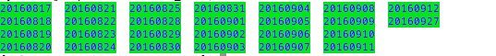
Summary
We had data for 28 days: throughout 8-18 – 09-11, 2016
Filter: i

Slide 3
Raw Photometry

Slide 4
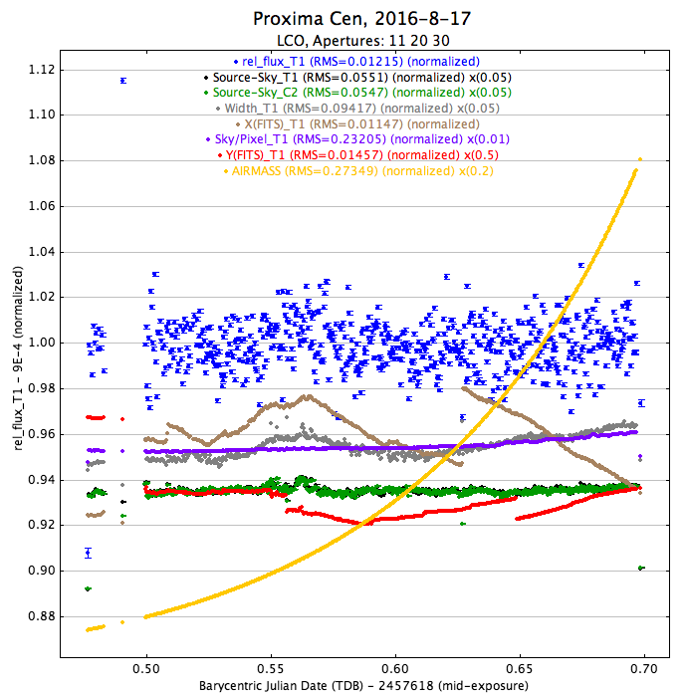
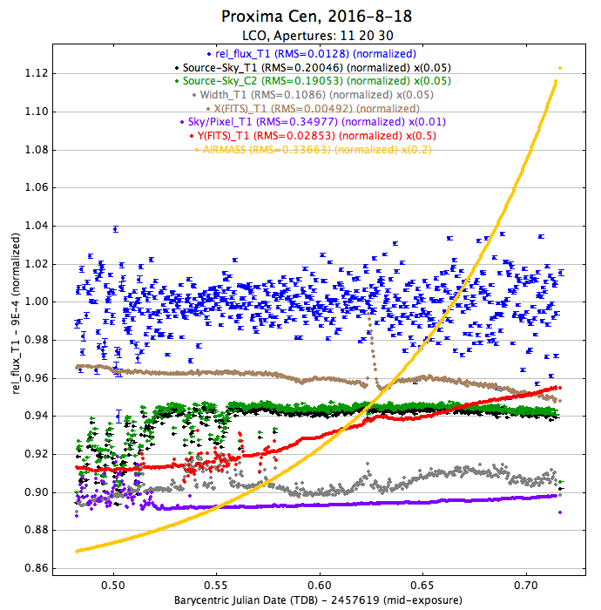
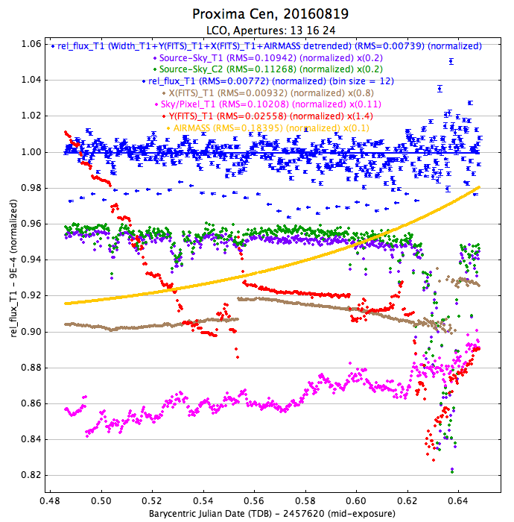
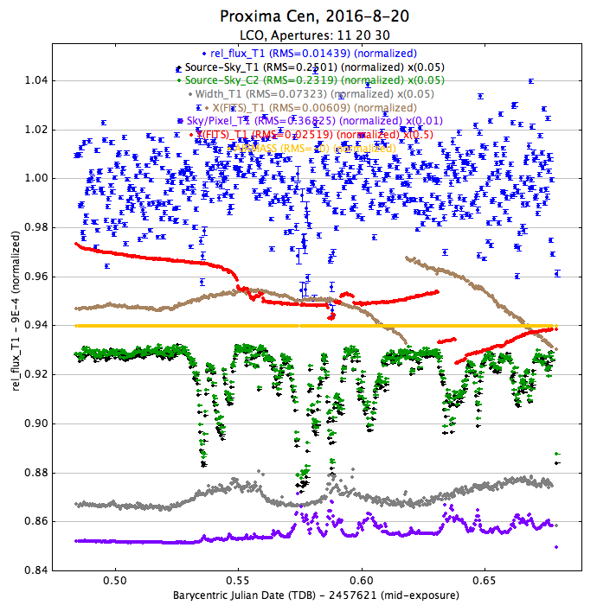
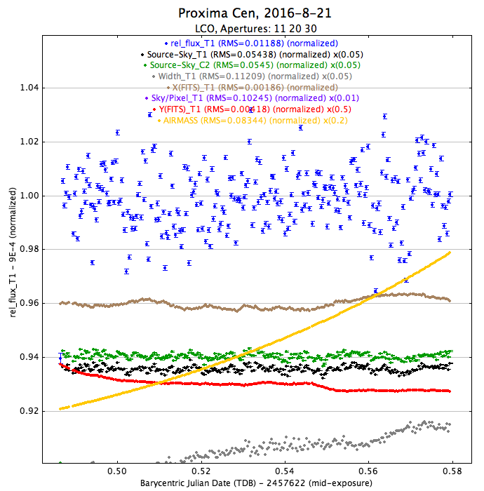
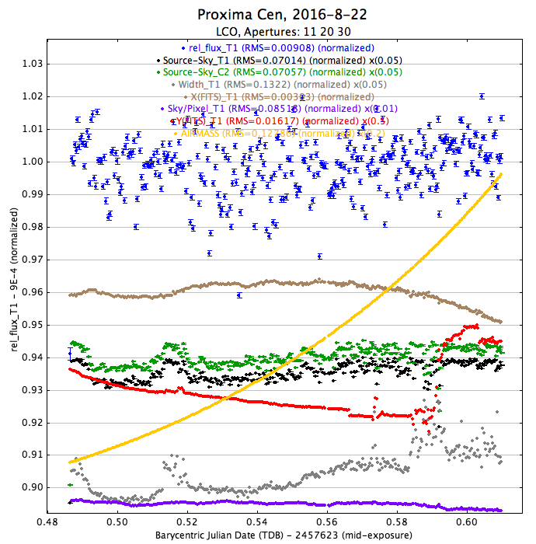

Slide 5
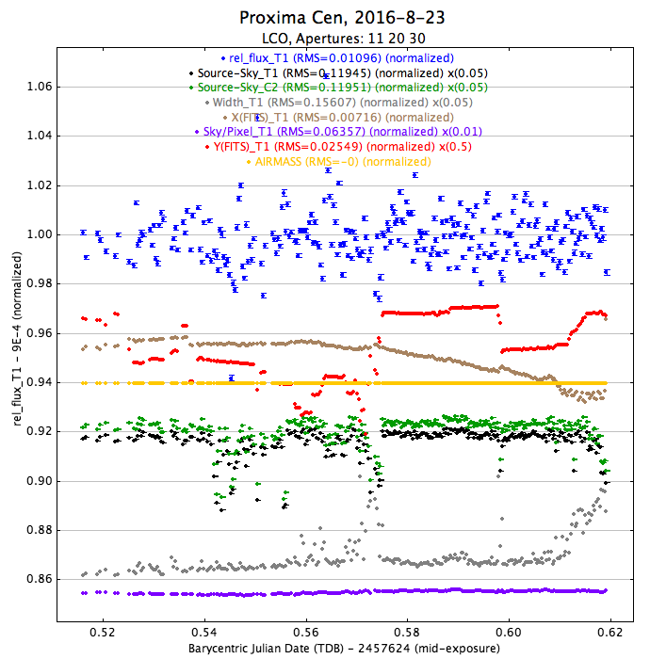
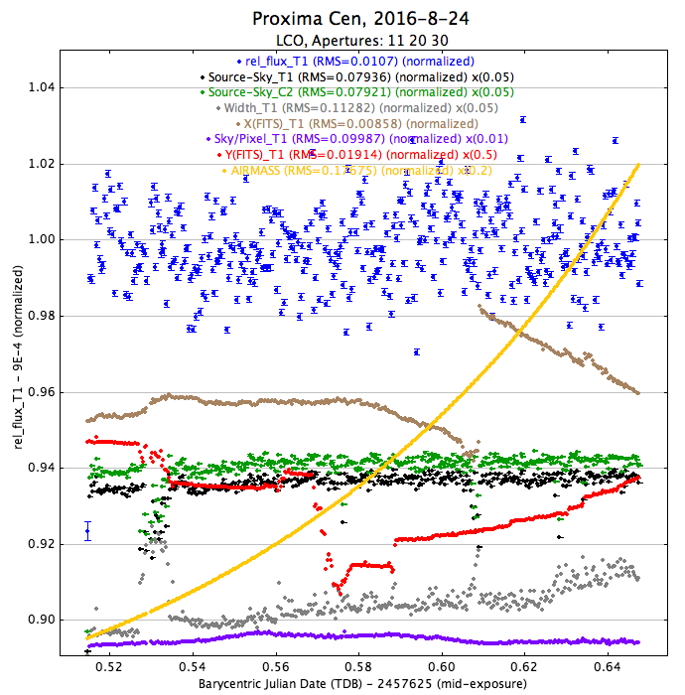
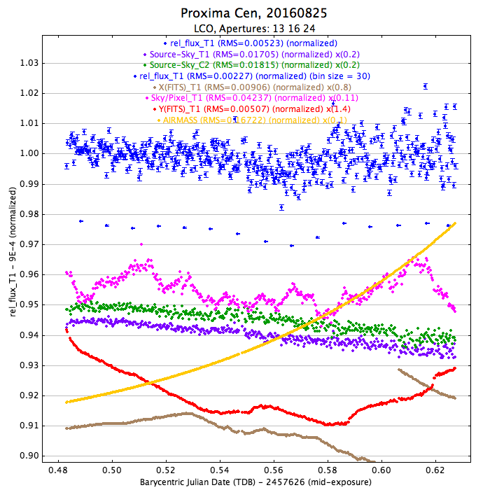
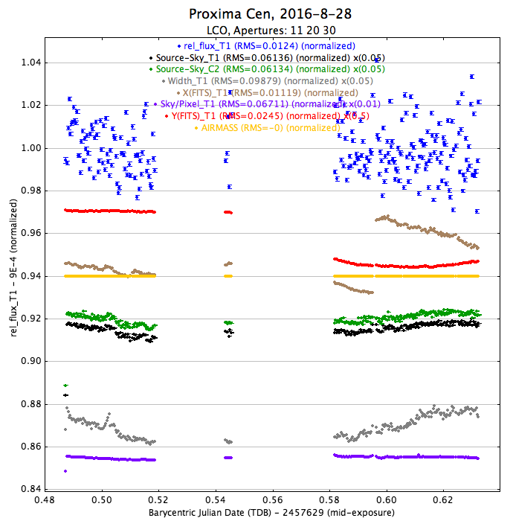
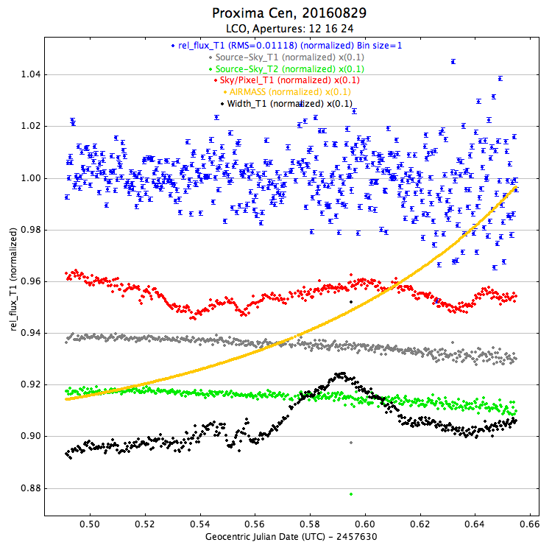
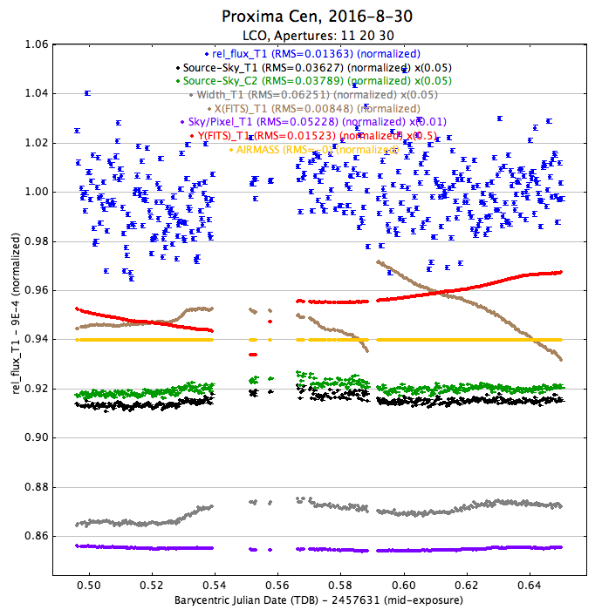
Transit?

Slide 6
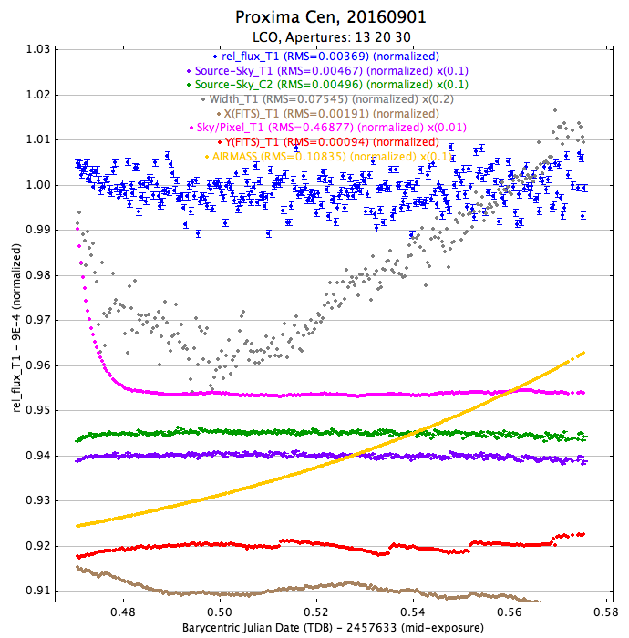
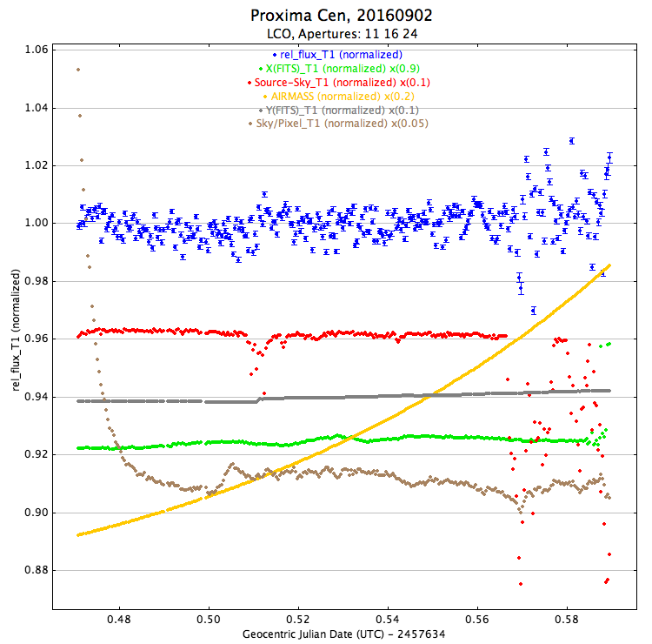
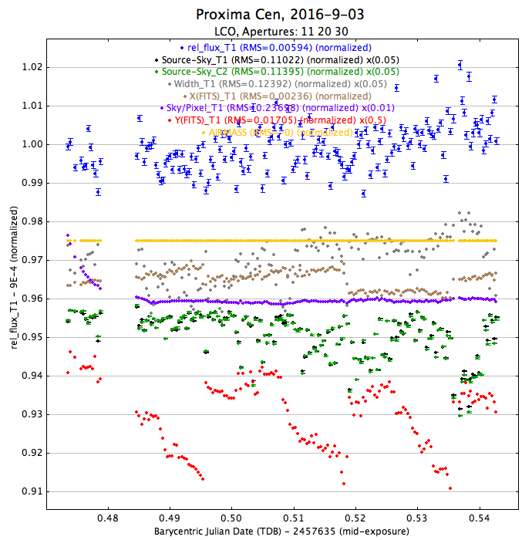
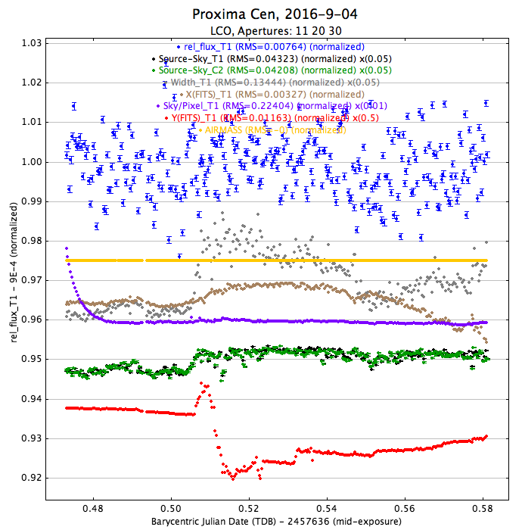
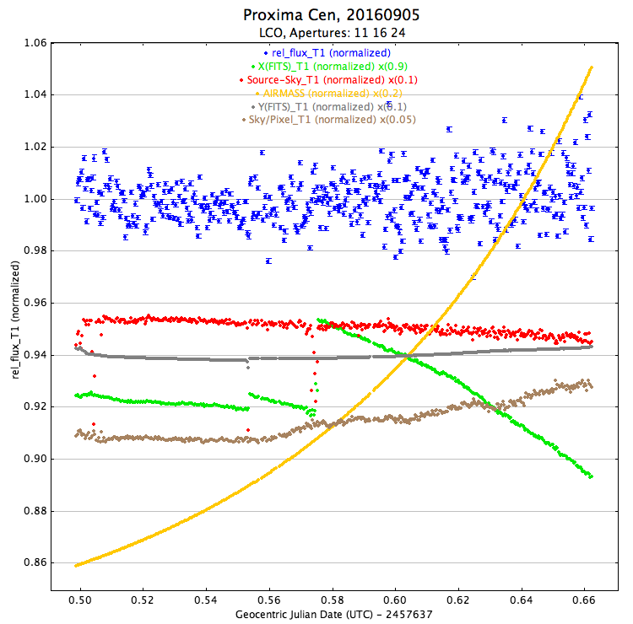
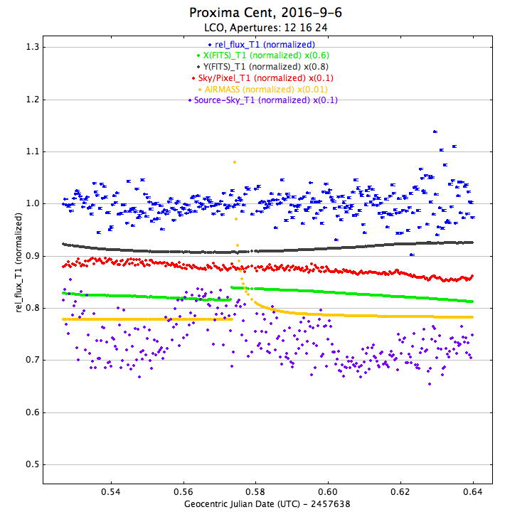

Slide 7
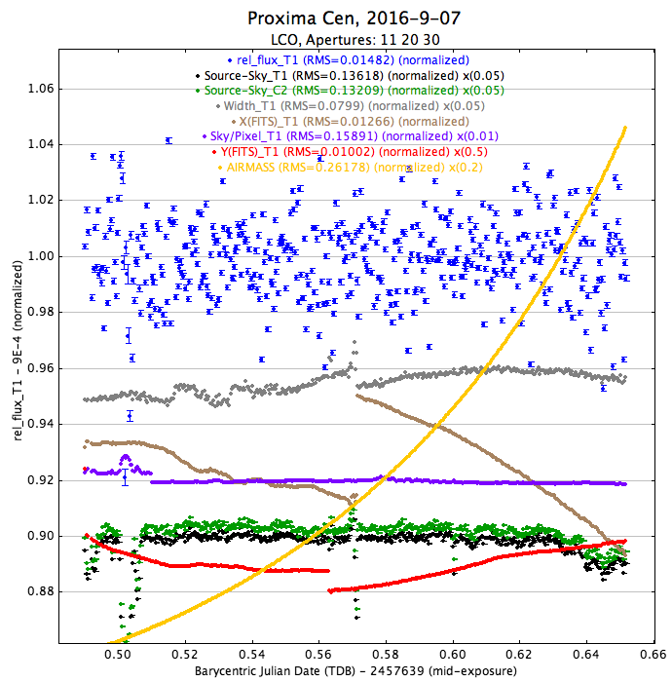
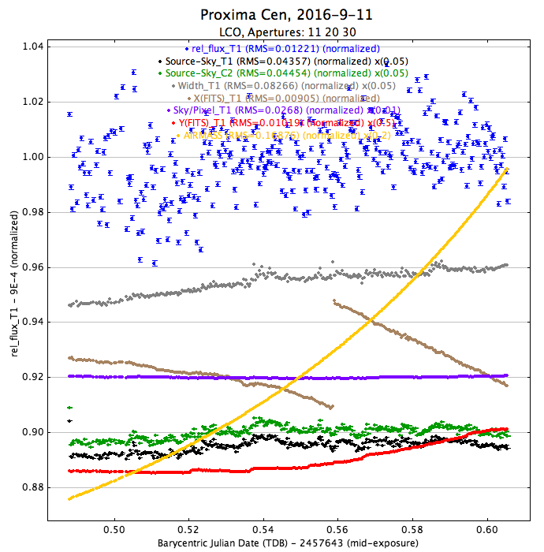
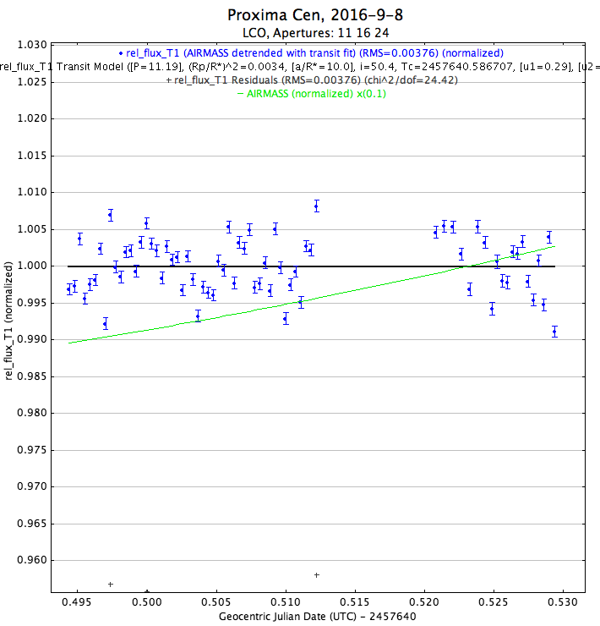
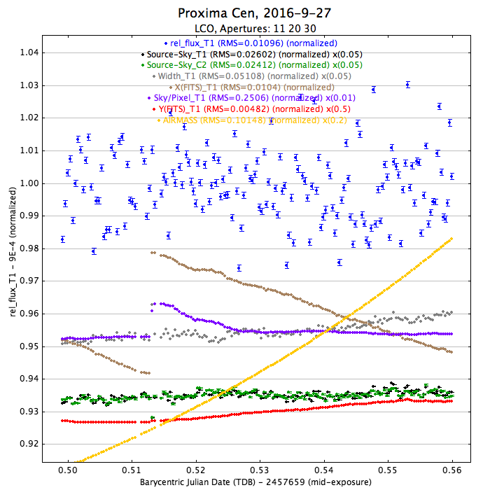
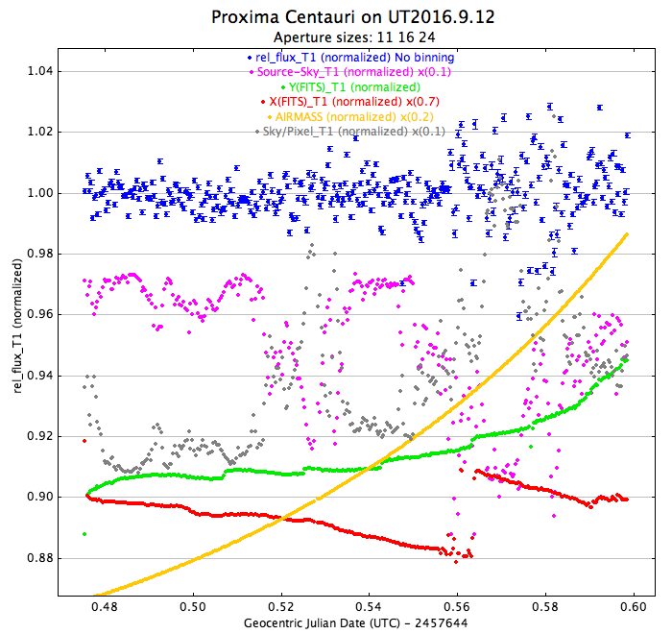

Slide 8
Potential signal: 8-25 An observed dip. No clear correlations with X, Y & reference stars

Slide 9
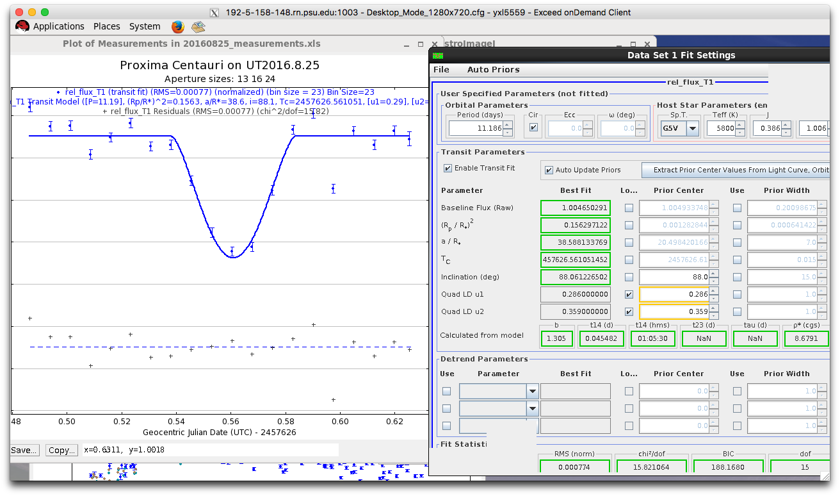

August 25th signal: both P_0=11.186days, and P_0/2 = 5.59 days are able to fit the data
P = 11.187day fit
Depth = 0.156
T_C = 2457626.561051
P = 5.59day fit
Depth = 0.006
T_C = 2457626.561075456

Slide 10
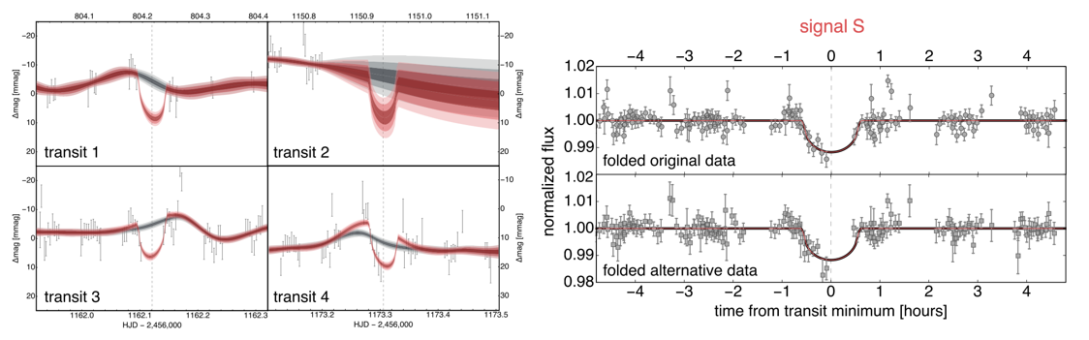
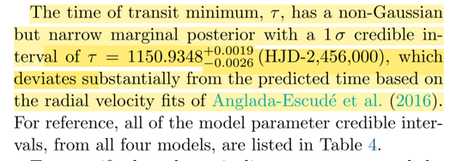
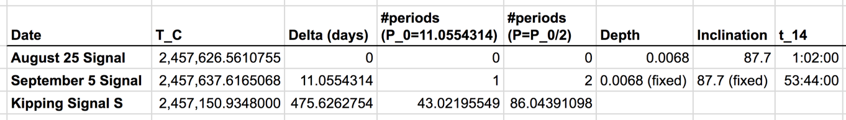
Comparing to Kipping signal S
Assumed period in Kipping: P=11.186 days (from Guillem et al.)

Slide 11
Proxima Centauri
Main results from Transit search
Yiting
Gummi

Slide 12
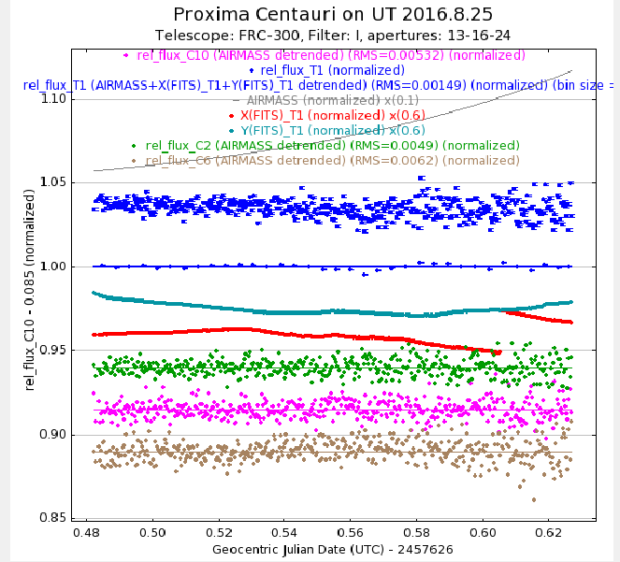
August 25th signal
An observed dip.
No clear correlations with X, Y & reference stars

Slide 13
August 25th signal: both P_0=11.186days, and P_0/2 = 5.59 days are able to fit the data
P = 11.187day fit
Depth = 0.156
T_C = 2457626.561051
P = 5.59day fit
Depth = 0.006
T_C = 2457626.561075456

Slide 14
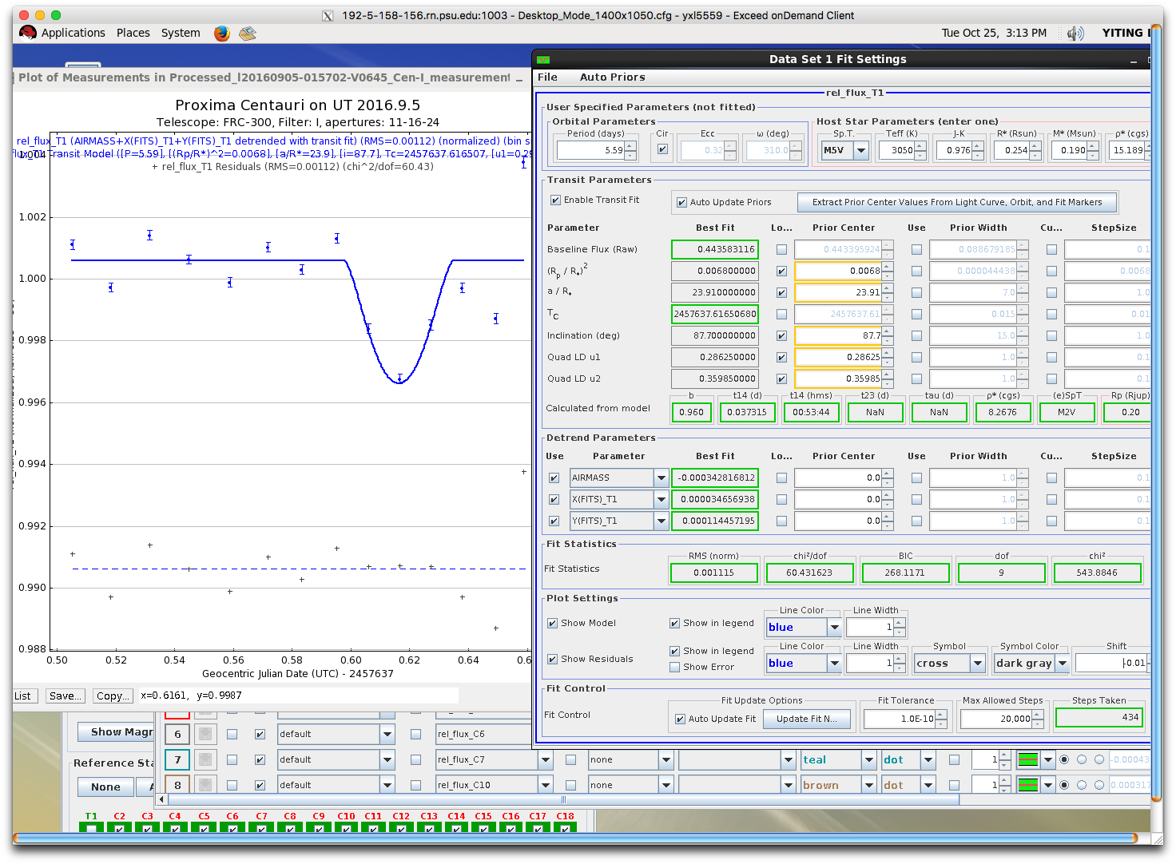
Signal on Sept 5, P=11.055 days later
Forced fit to be the same

Slide 15
Comparing to Kipping signal S
Assumed period in Kipping: P=11.186 days (from Guillem et al.)

Slide 16
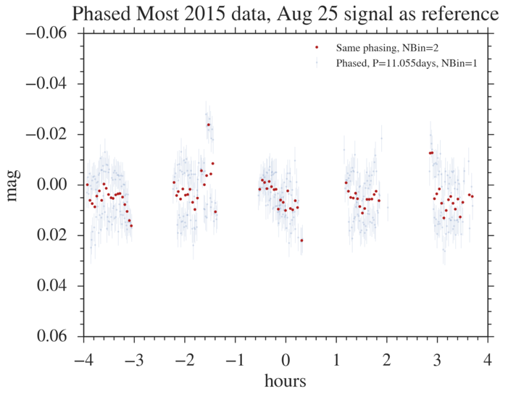
Phasing Most 2015 data from Kipping, P = 11.055
No clear dip at phase = 0, using P = 11.055 days

Slide 17
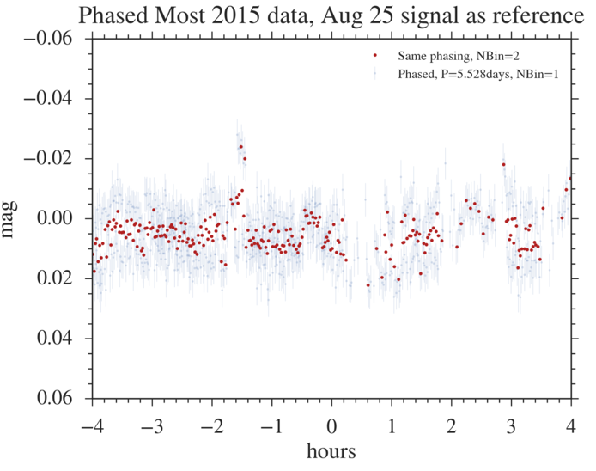
Phasing Most 2015 data from Kipping, P = 11.055/2
No clear dip at phase = 0, using P = 11.055/2 days

Slide 18
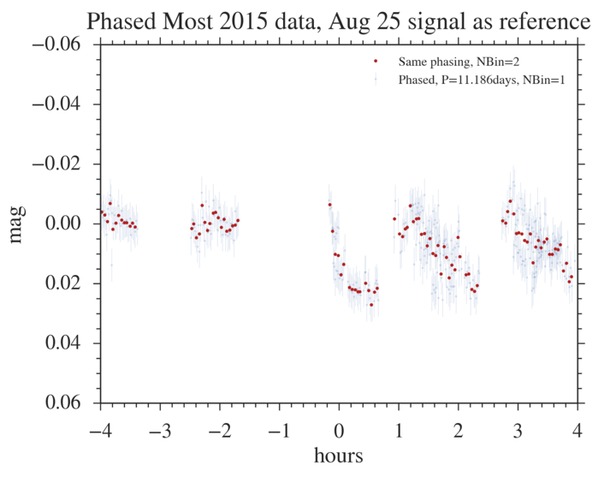
Phasing Most 2015 data from Kipping, P = 11.186days
Signal S is evident if P = 11.186
However, Signal S is 0.02, while Aug 25 is 0.0068

Slide 19
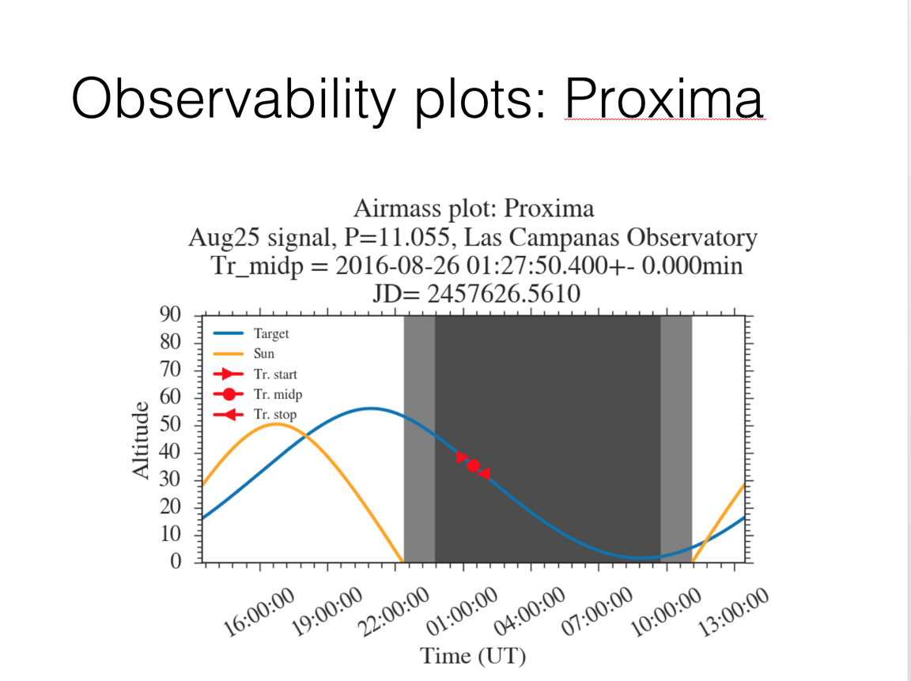

Slide 20
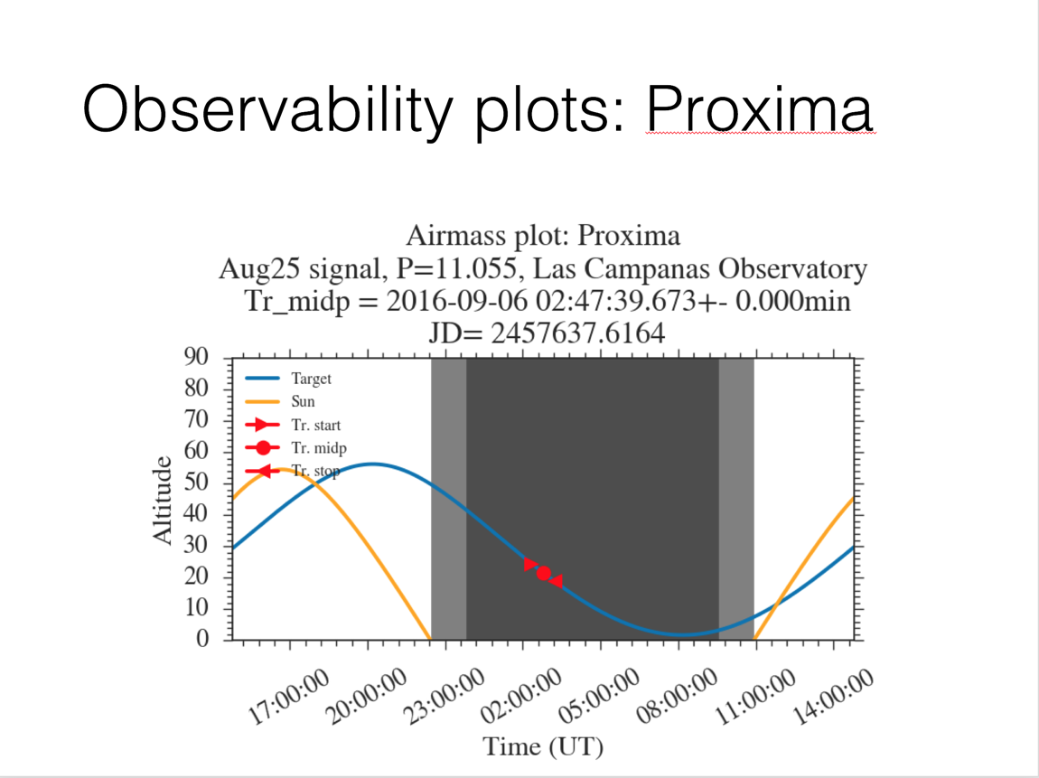

Slide 21
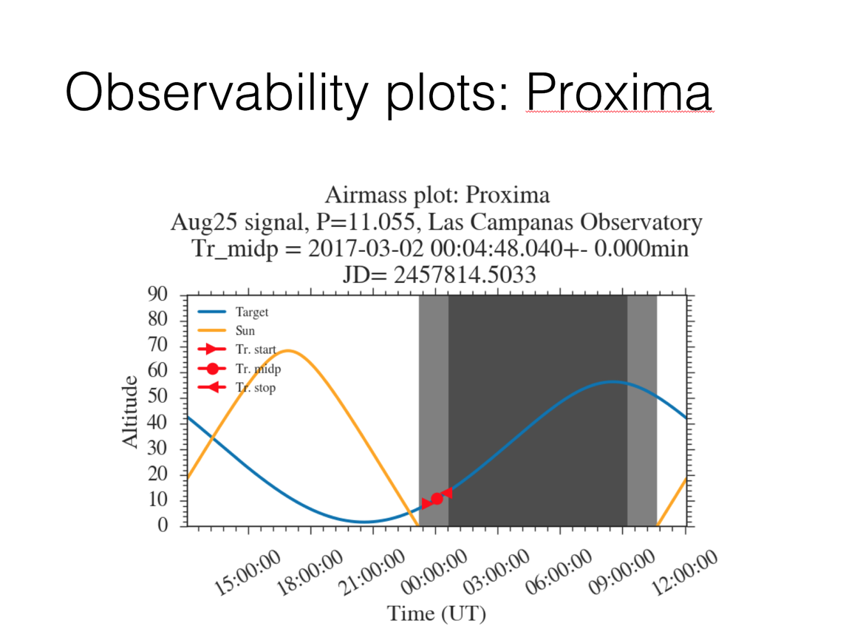

Slide 22
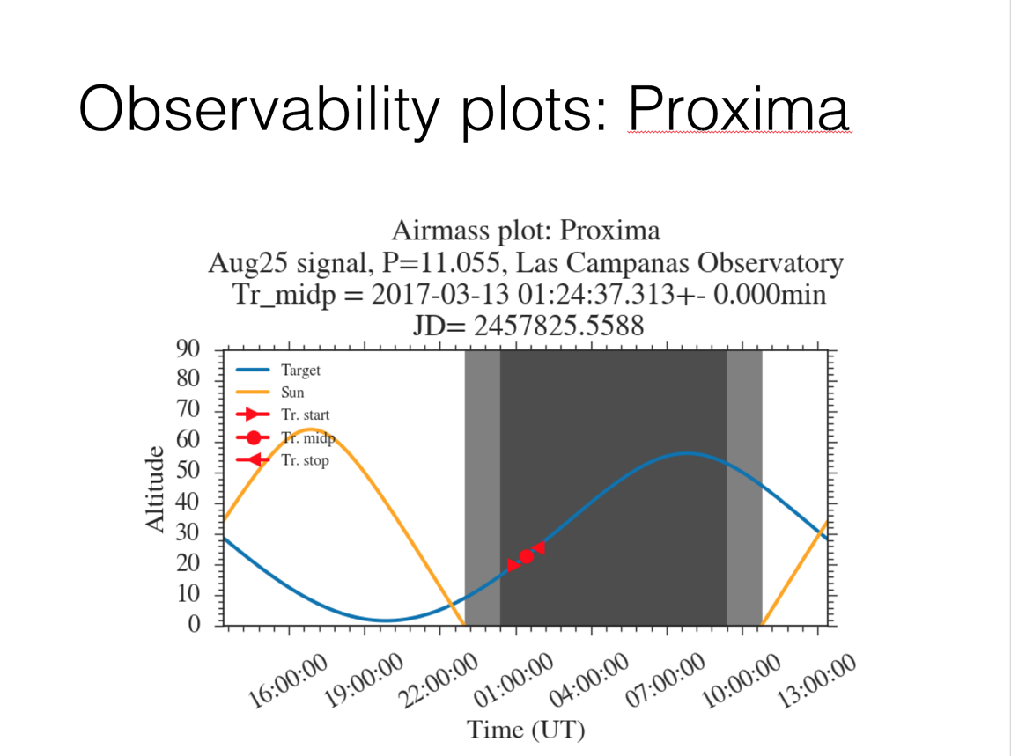

Slide 23
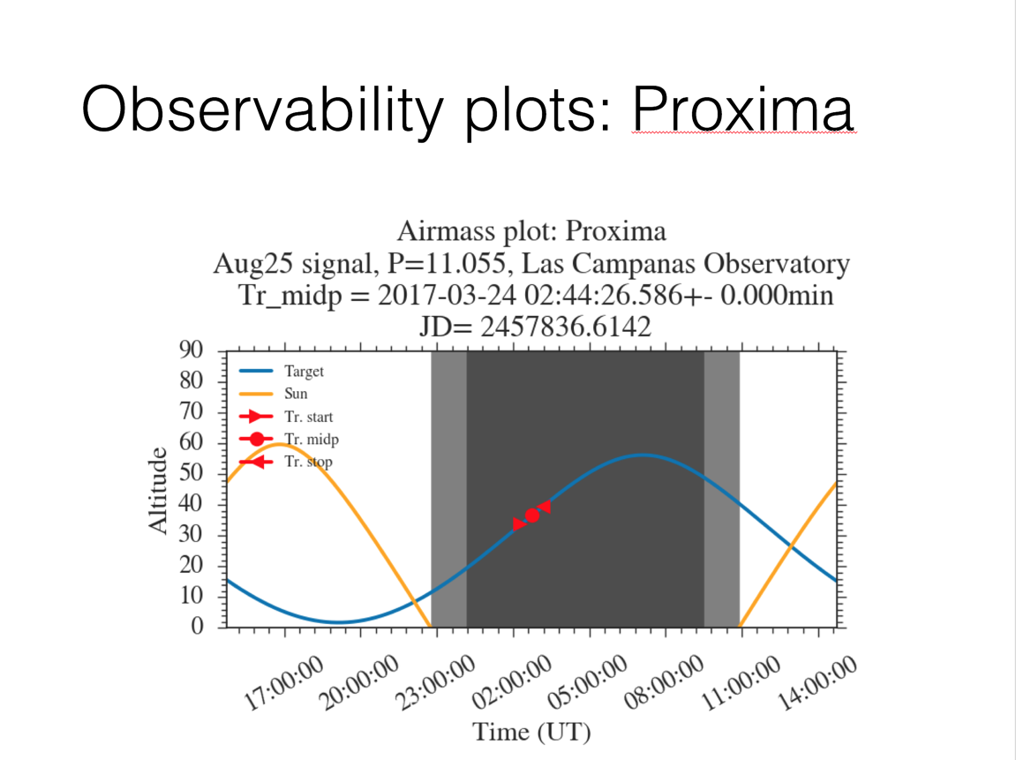

Slide 24
Extra: Other signals

Slide 25
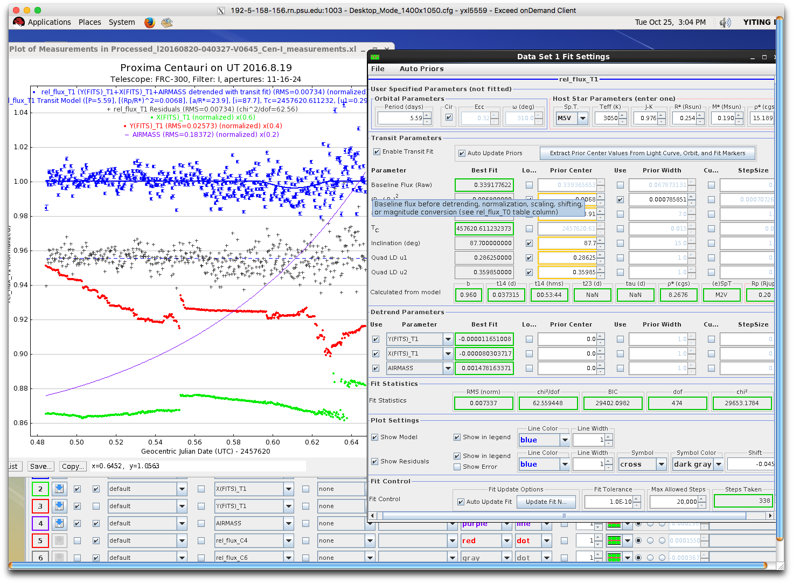
Signal on August 19th
T_C = 2457620.613165432
Detrended with X, Y and Airmass

Slide 26
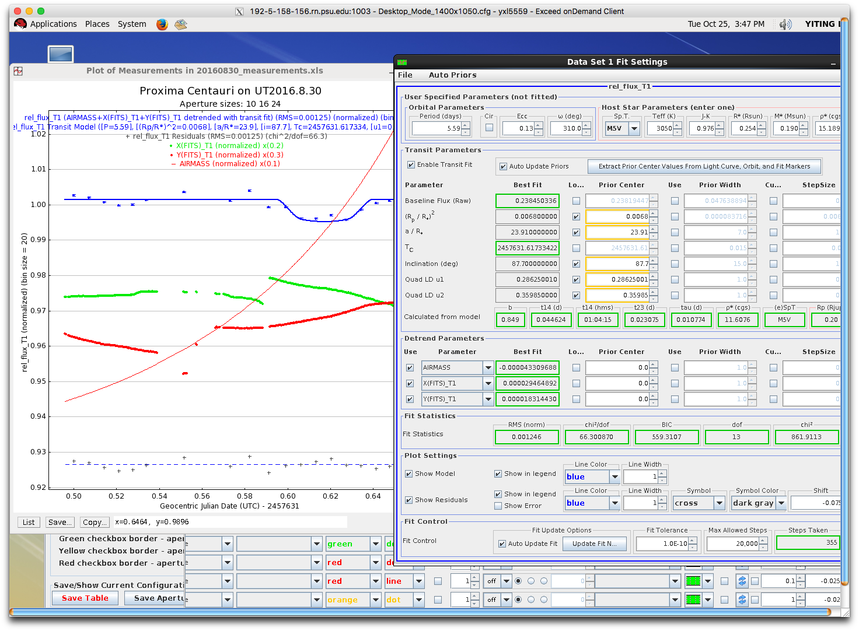
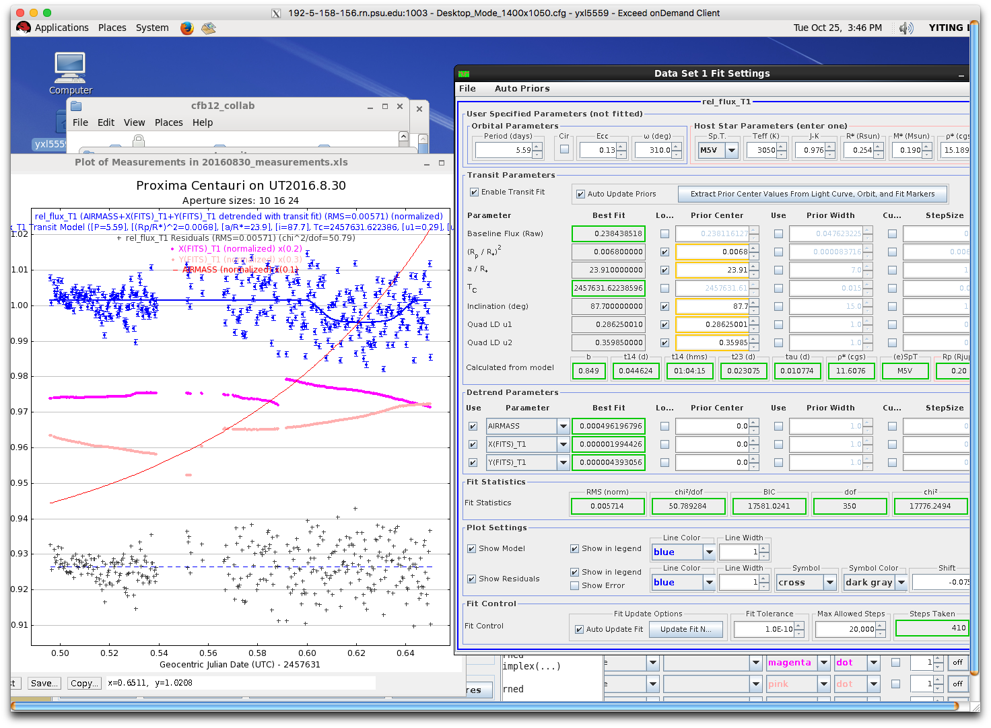
Fit August 18 (forced fit)
Extra (not likely)

Slide 27
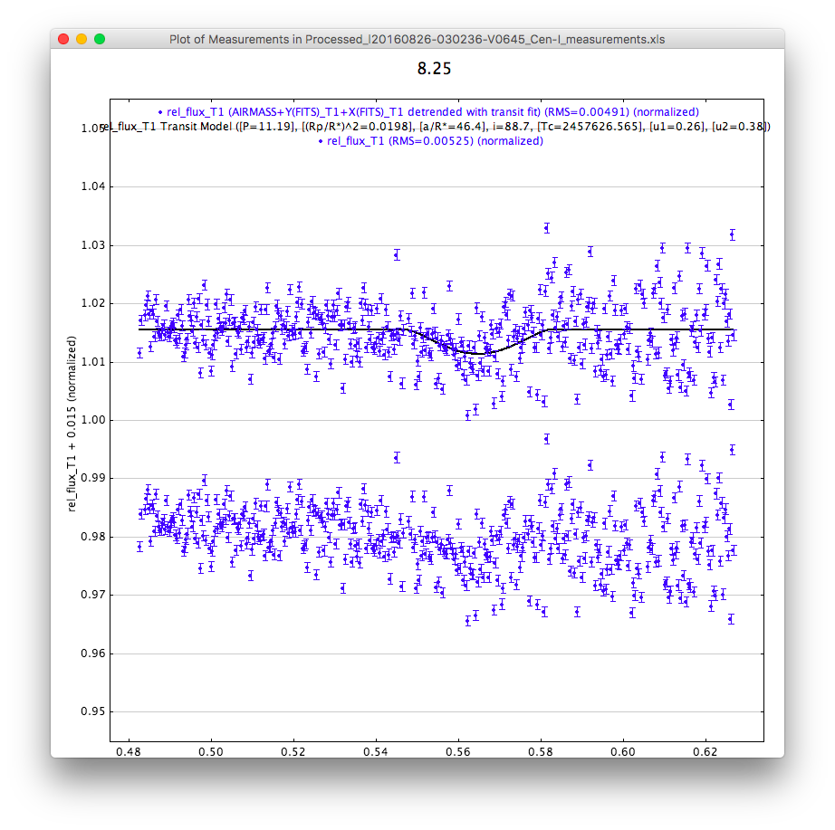
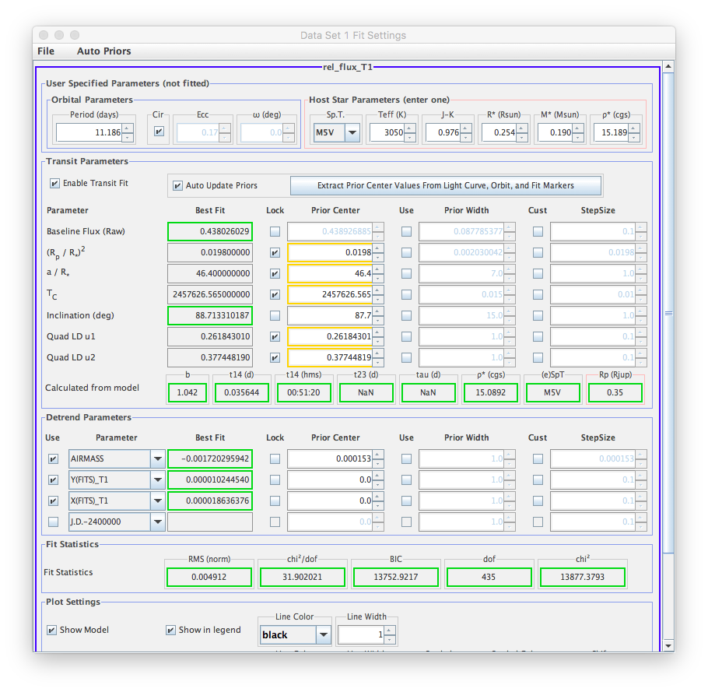
Fit August 25, P = 11.186days (forced fit)

Slide 28
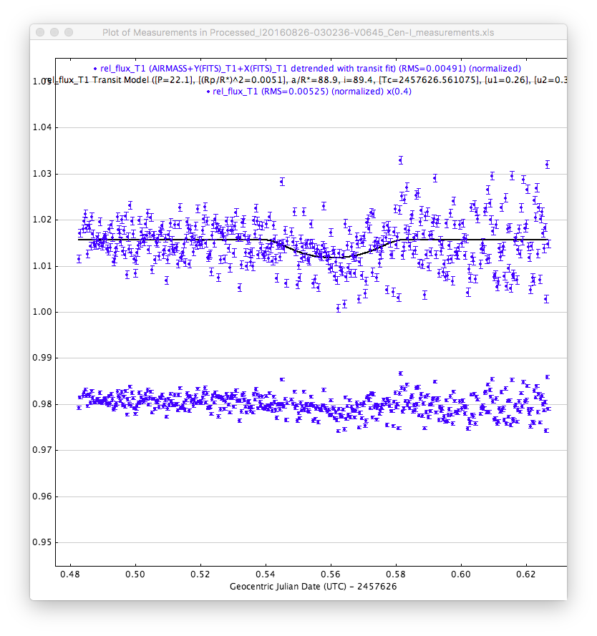
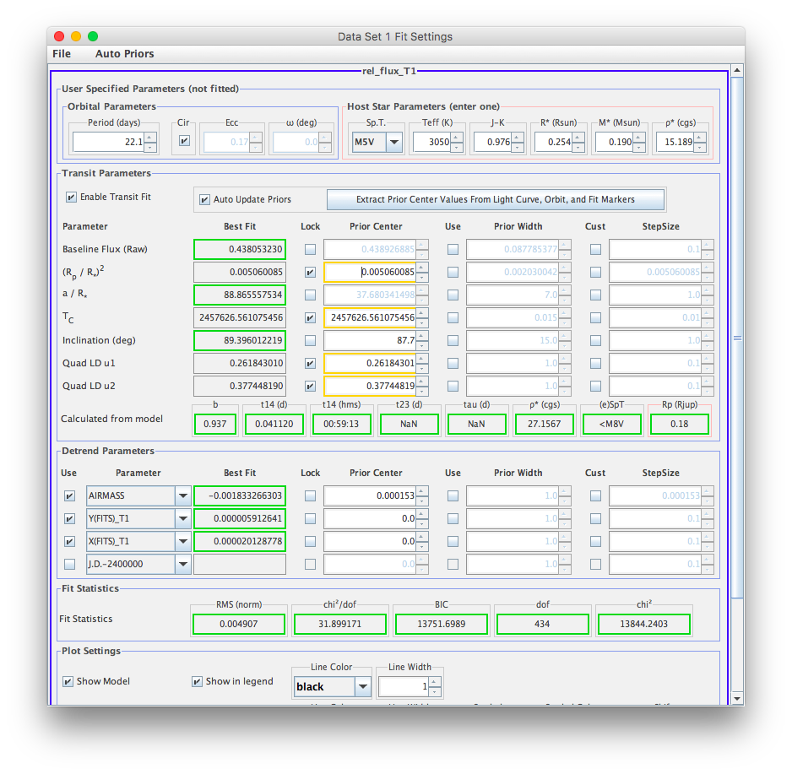
Fit August 25, P = 22.1days

Slide 29
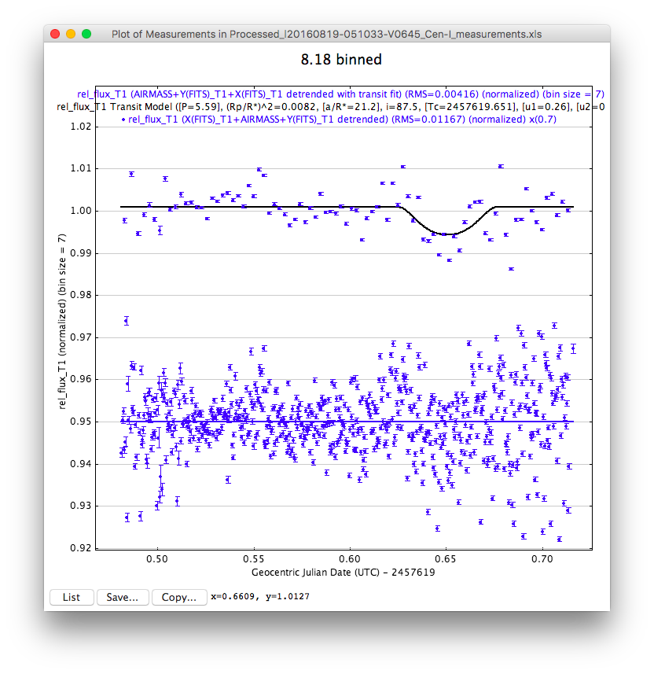
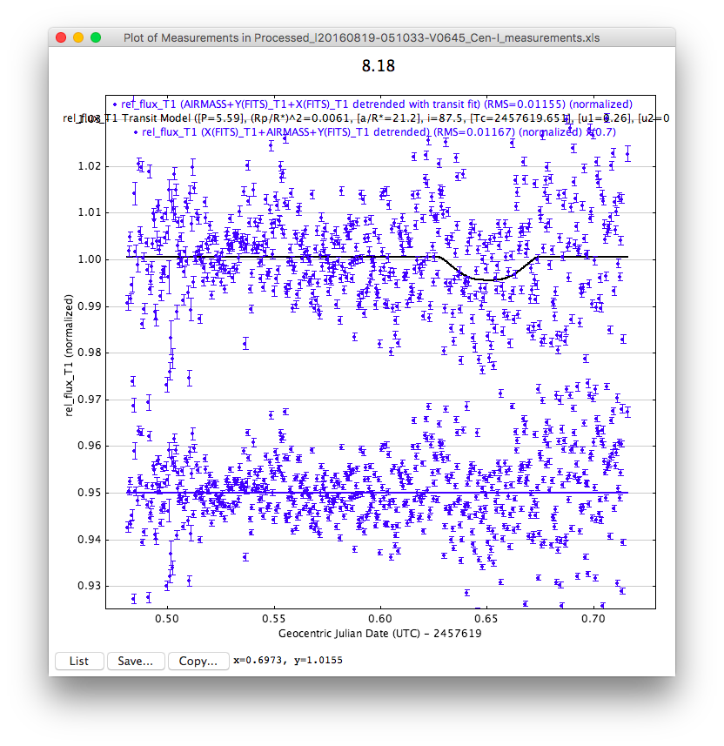
Fit 8.18 fixed P=5.59, Tc=245619.651, a/R*=21.204756129

Slide 30

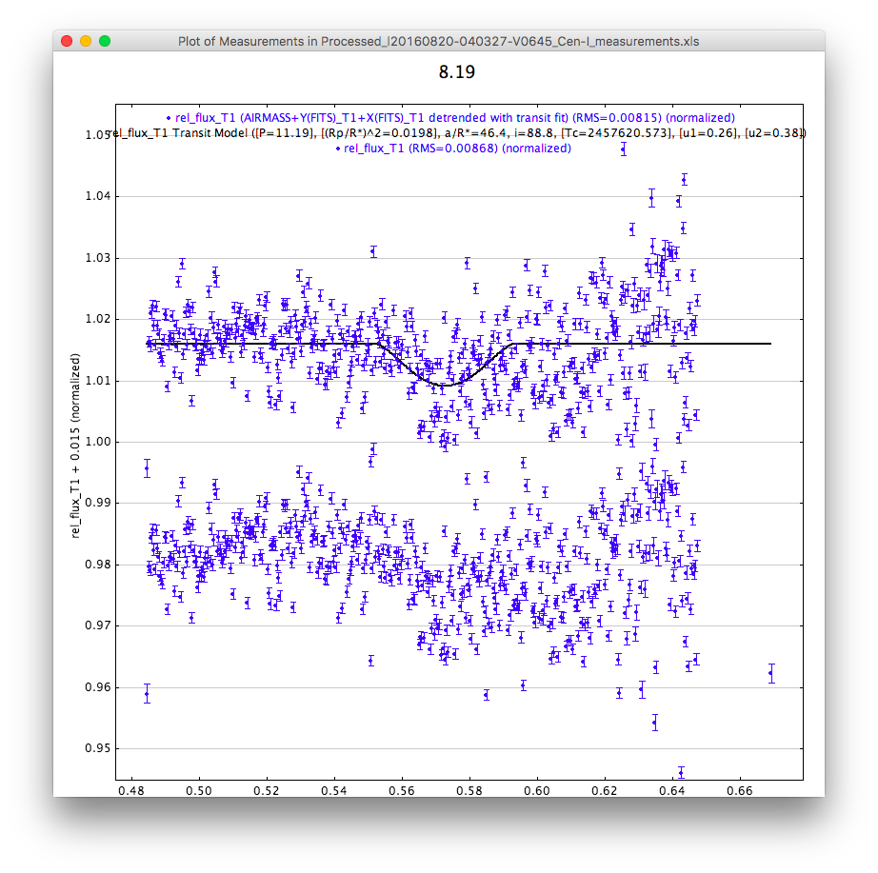
Fit 8.19 fixed P=11.186, Tc=2457620.573, (Rp/Rs)^2=0.0198

Slide 31

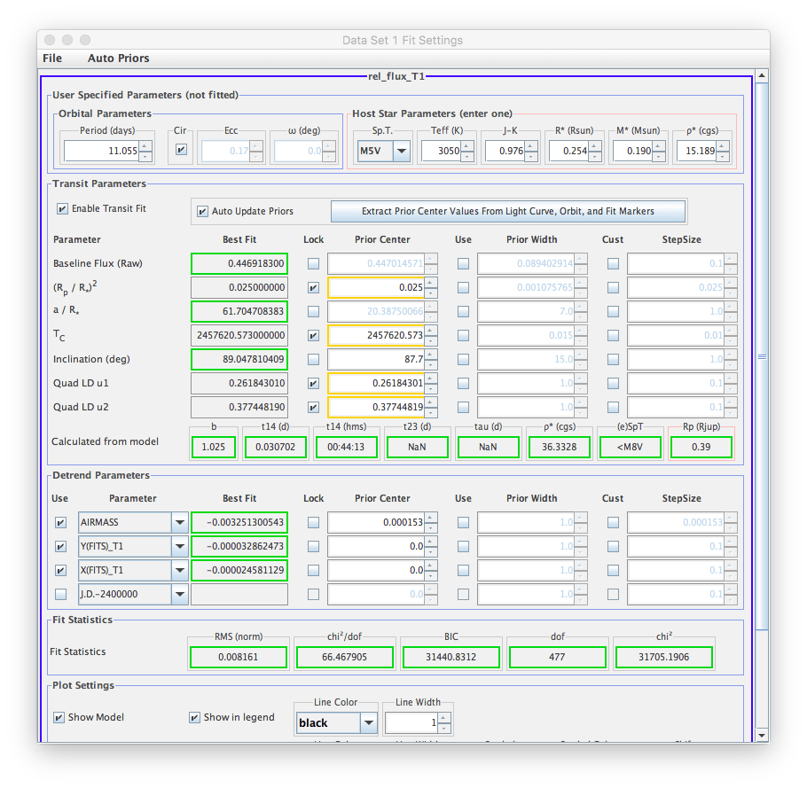
Fit 8.19 fixed P=11.055, Tc=2457620.573, (Rp/Rs)^2=0.025

